Slide 1

Data Cleaning, Analysis and Visualization of EA Sports FIFA Soccer Game

Slide 2
Team Members
Anmol 2017006023
Ankur Saurabh 2017013084
Aryamaan

Slide 3
Introduction
Soccer has become the most popular sport in the world over the last century, but very little is known about its structure.
One of the main reasons for that is the lack of a large-scale dataset. Despite the sport being constantly discussed and recorded worldwide, in every season there are several events that neither specialists nor fans can characterize or predict accurately.
In this research, we propose the use of a new dataset, the FIFA Soccer video game dataset, to better understand soccer. We describe the available data, justify its use and discuss possible applications. Finally, we show the potential of the dataset by analysing and visualising the data in different forms.

Slide 4
Language Used
Python
simple syntax
write programs with fewer lines
runs on an interpreter system, meaning that code can be executed as soon as it is written.
can be treated in a procedural way, an object-orientated way or a functional way.
was designed for readability
similarities to the English language with influence from mathematics.
uses new lines to complete a command
relies on indentation, using whitespace, to define scope

Slide 5
Problem
We don’t have a lot of information (specially India)
Soccer is not as exposed to “big data” as much as cricket or American football
We believe data analysis will improve overall scouting
Will help club managers, scouts to be more efficient
Help coaches with team formations
Help players who play Fifa competitively
We believe the conception that real data could reveal more insights about the characteristics of some specific football players

Slide 6
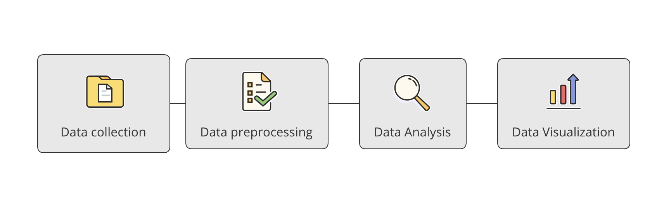
Process

Slide 7
Libraries Used (currently)
Numpy
Pandas
Matplotlib
Seaborn
Os … etc.

Slide 8
Some example of viz we’ll perform
Most preferred foot of players
Comparison of Positions and Players
Distribution of Wages of Players
Count of players on Basis of their skill moves
Count of players on Basis of Height
… and 15+ more!

Slide 9
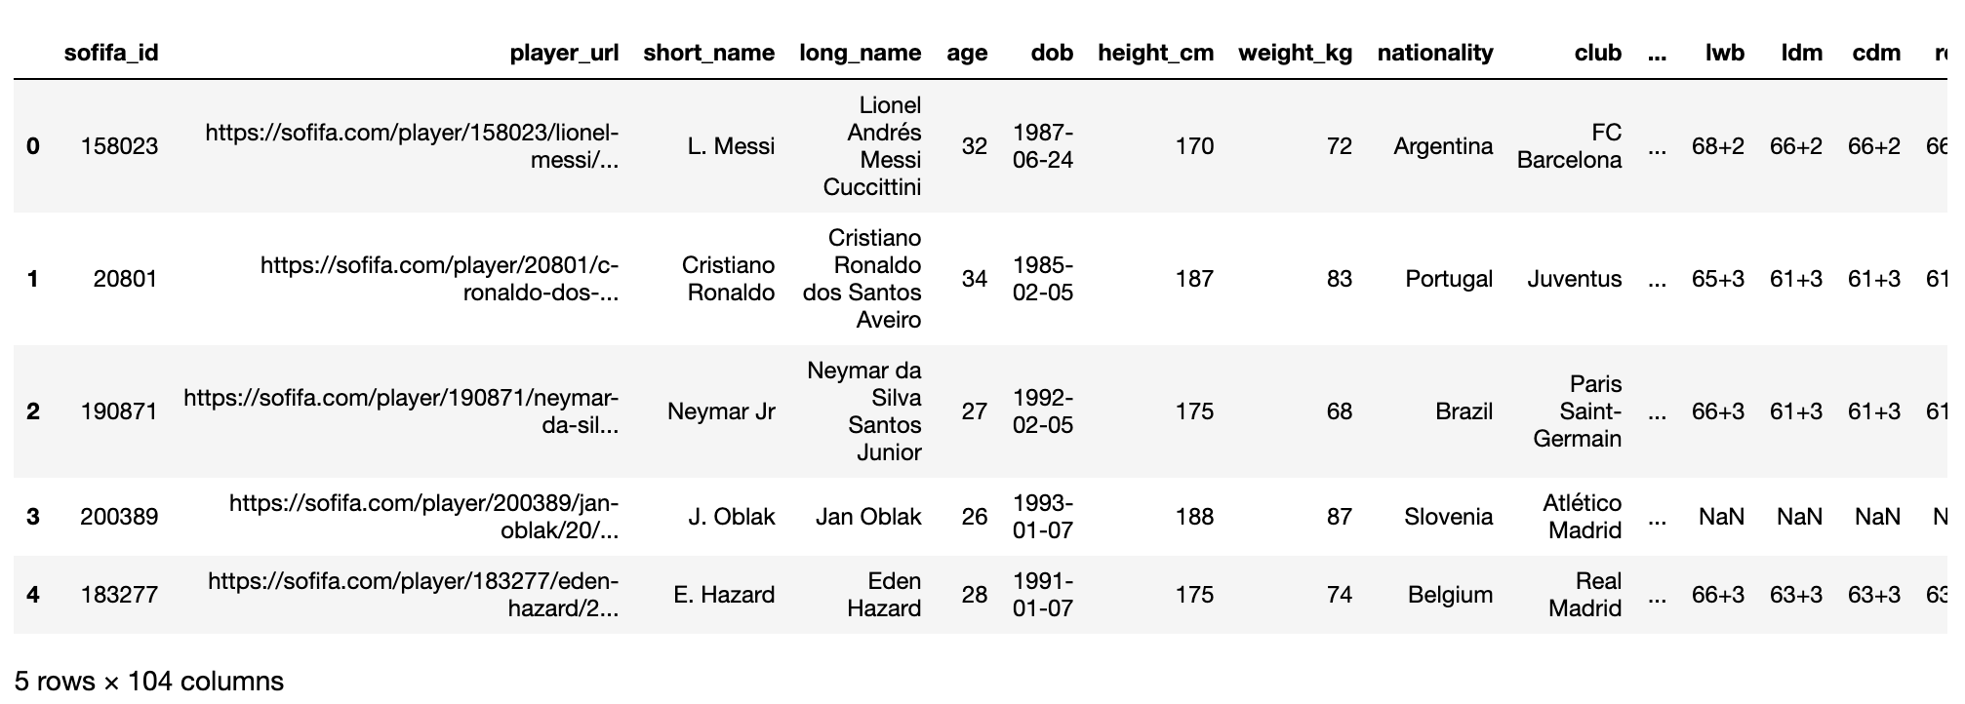
Data Showcase

Slide 10
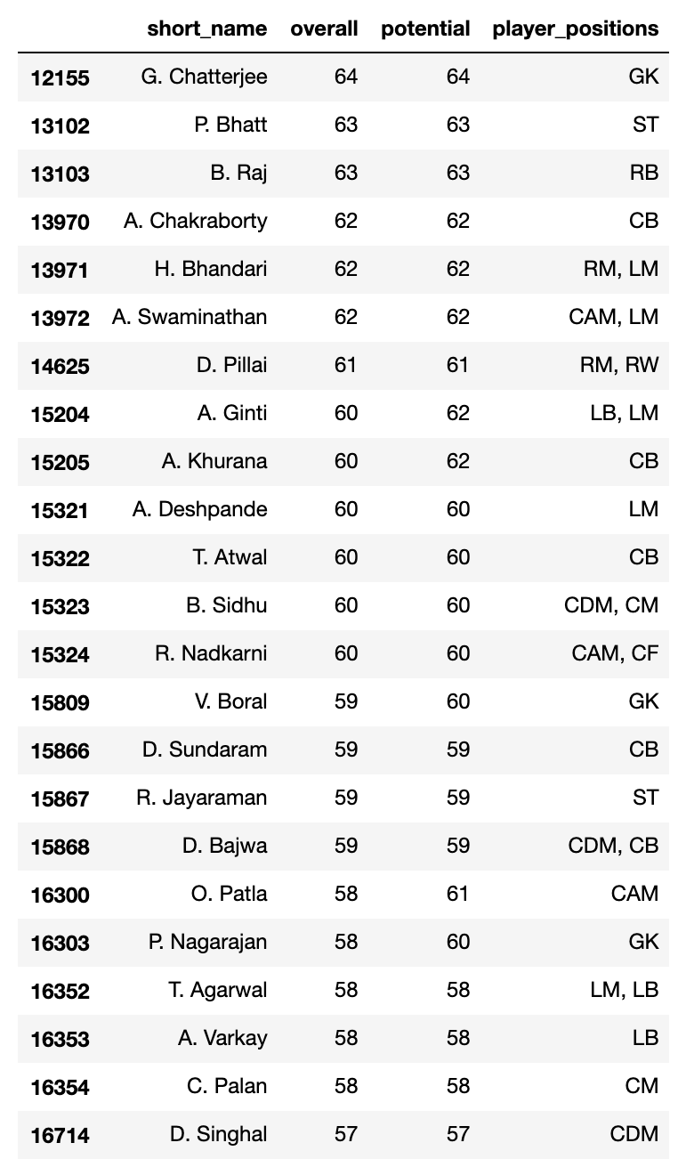
Indian Players in Fifa 20

Slide 11
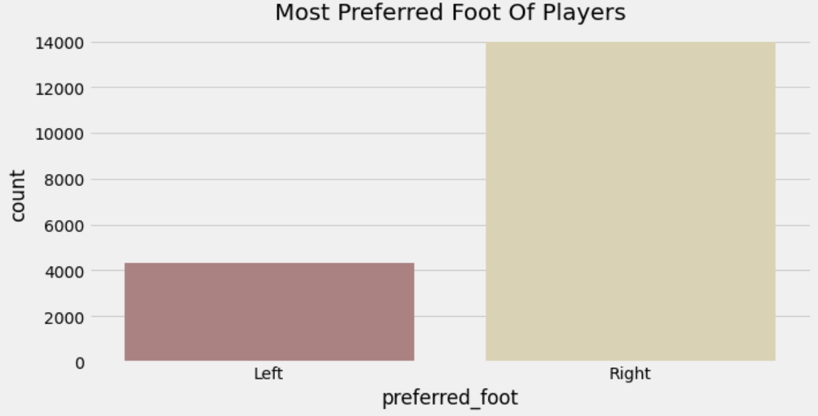
What foot does most player prefer?
Most players’ dominant foot is right.

Slide 12
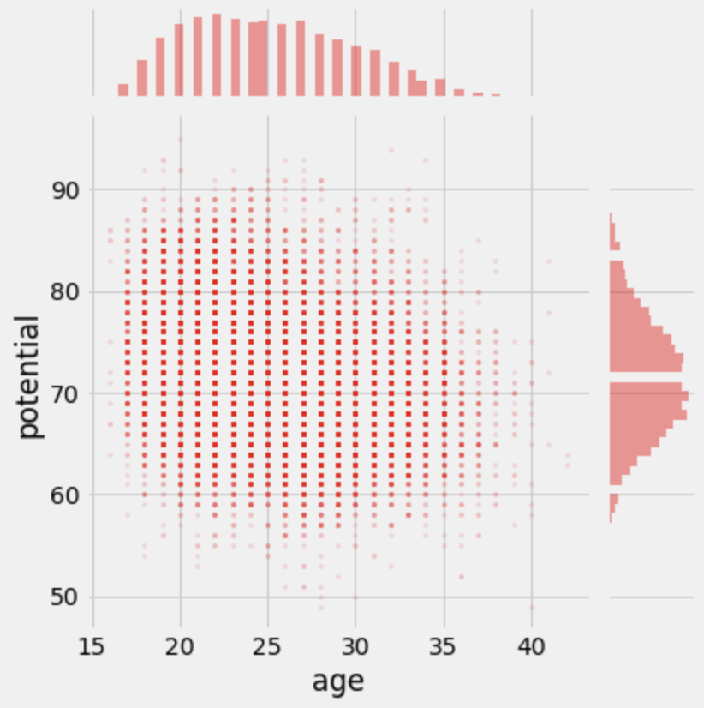
At what age does a player has most potential?
Players around the age of 24-26 have the most potential

Slide 13
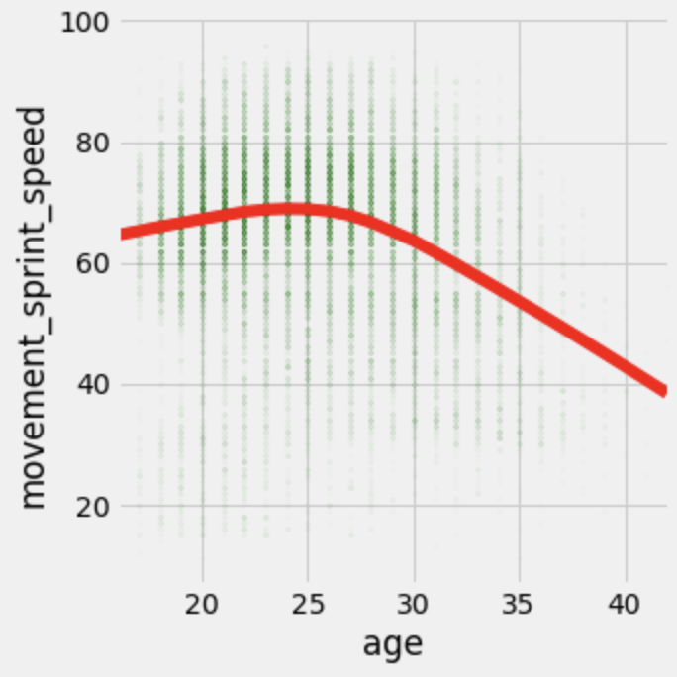
At what age does a player run fastest?
Players around the age of 25 are fastest sprinters

Slide 14
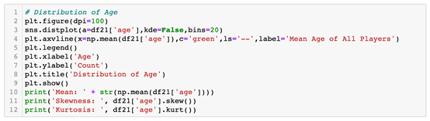
Univariate Data Analysis

Slide 15
We are using Matplotlib to plot age distribution using a distribution plot. We also show the mean age, skewness, kurtosis of the data.
Using Matplotlib to plot BMI distribution using distribution plot. We also show the mean BMI, skewness, kurtosis of the data. BMI stands for Body Mass Index. It is based on a person's height and weight. It is categorized into classes, the main ones being underweight, normal weight, overweight, obese.

Slide 16
We group the data based on the team playing the position of the player. We remodel the data frame to contain only two columns, one with the name of the position, the other with the number of players that play in that position. We then plotted the result using a bar graph with vertical orientation.

Slide 17
Bi & Multi-variate Analysis
we try to understand the relationship between the overall rating of a player and the age. We use a scatterplot with Ordinary Least Squares values (OLS) as the trendline. OLS is a method for estimating the unknown parameters in linear regression models. It determines the parameters of a linear function through the principle of least squares, minimizing the aggregate of squares of the differences between the observed variable in the given dataset.

Slide 18
Player Classification (Machine Learning)
we use various machine learning algorithms to bin players into their respective position types. However, before we begin, we much know what exactly we are doing, so below is a short explanation of terms you must already be familiar with.

Slide 19
Recommendation System
We initialize a new variable and pass it the value of data21, which is a copy of our FIFA 21 data frame. Then, we create a new variable sample that only has all the columns, which are float or integers. We fill the missing values by the mean of the column; then we drop the sofifa_id column, which has IDs of all the players; this column is relevant to SOFIFa but not us. Then, we transform the data using StandardScaler and store the values in variable X. After that; we apply KD Tree on the data with six neighbors, finally fitting and storing the result.

Slide 20
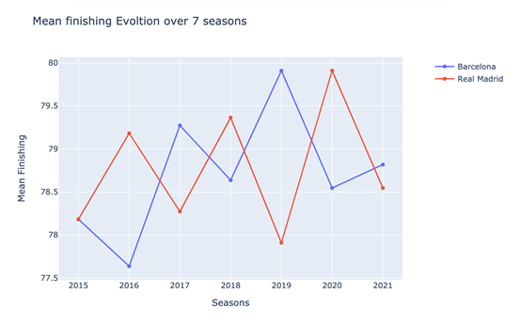
Analysis of El Classico

Slide 21
From above, we see that in the year 2015, Barcelona and Real Madrid were in equal standing. In 2016, Real Madrid had better finishing than Barcelona if we look at real matches; in 2016, Real Madrid won El Classico and the second 2016 match was a draw. In 2017, Barcelona had better finishing, and in reality, Barcelona won both matches. In 2019 Barcelona won the El Classico match in real life, and above, we can see that Barcelona had better finishing in 2019. For the year 2020, Real Madrid won both the matches in reality and above; we can see that the FIFA dataset also shows that Real Madrid had better finishing than Barcelona in the 2020 season.

Slide 22
From our study, we manage to understand football trends and events better. We did various Exploratory Data Analyses and used machine learning classification algorithms like Support Vector Machine, Decision Tree, K-nearest Neighbors, and Logistic regression to classify and recommend players. We also analyzed a widely discussed event (El Classico) and depicted how our dataset can provide precious insights. This paper backs the idea that the players' performance indicators heavily

Slide 23
END
THANK YOU

